Slide 1

WELCOME TO MY PROJECT PRESENTATION
Data is the new oil- Clive Humby

Slide 2


MASTER OF SCIENCE IN DATA SCIENCE AND MANAGEMENT JOINTLY OFFERED BY INDIAN INSTITUTE OF TECHNOLOGY, INDORE & INDIAN INSTITUTE OF MANAGEMENT, INDORE
STATISTICAL MODELING: INTERDEPENDENCE OF STOCK MARKET INDICES AND OIL PRICES USING COPULAS
PROJECT PRESENTATION

Slide 3

Agenda
Abstract
Introduction
Literature Review
Copula Introduction
Research Data
Methodology
Results and Discussions
Conclusion
Future Work

Slide 4
ABSTRACT
In this study, we investigate the relationship between oil price returns and stock market index returns of various countries focusing on the periods before, during and after the Covid-19 pandemic.
We use Brent and OPEC oil price series, converted into local currency to account for exchange rate effects, and employ copula models to capture the general dependence structure.
Our findings reveal that dependence measures including Pearson's rho and Kendall's tau were relatively small pre-Covid, increased during the Covid period, and decreased post-Covid.
The Covid-19 pandemic amplified the influence of oil prices on stock markets, with notable asymmetrical dependence observed in India and France.
The degree of dependence varied with tail dependencies observed for large oil-consuming countries like India and France.
Most relationships exhibited symmetrical dependence, though exceptions were found particularly during extreme market conditions.
Our results underscore the impact of global economic disruptions on the interdependence between oil prices and stock markets offering significant insights for investors and policymakers.

Slide 5
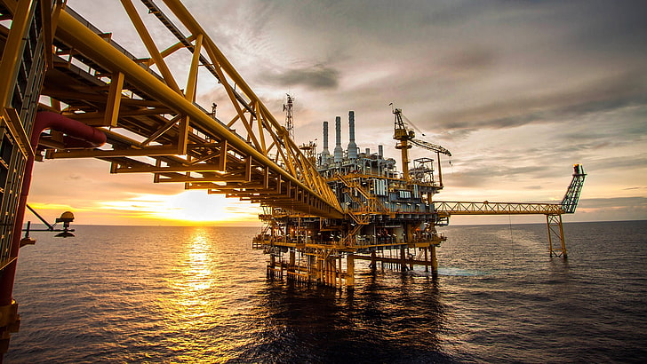



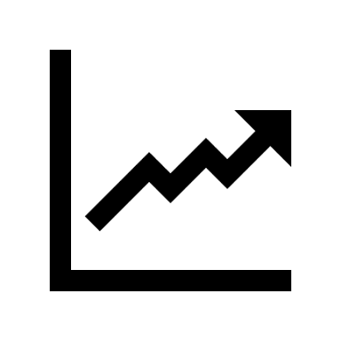
INTRODUCTION
BACKGROUND AND CONTEXT
Growing Energy Demand
Economic growth increases energy demand.
Higher demand for crude oil as economies expand.
Global transportation sector relies on gasoline and diesel.
Crude oil products make up one-third of world energy consumption.
Oil’s historical role as a primary fuel.
Increased consumption in developing nations likes India and China.
Major oil producers influence global output and pricing.
Dependence on Petroleum
Link between oil prices and economic health varies by country.
Positive GDP impact for oil producers (e.g., Saudi Arabia).
Negative impact for net consumers (e.g., France).
Oil’s Economic Influence
Oil Prices and Economic Health

Slide 6
Growing Energy Demand
Economic growth increases energy demand.
Higher demand for crude oil as economies expand.
Global transportation sector relies on gasoline and diesel.
Crude oil products make up one-third of world energy consumption.
Oil’s historical role as a primary fuel.
Increased consumption in developing nations likes India and China.
Major oil producers influence global output and pricing.
INTRODUCTION
Link between oil prices and economic health varies by country.
Positive GDP impact for oil producers (e.g., Saudi Arabia).
Negative impact for net consumers (e.g., France).
BACKGROUND AND CONTEXT
Dependence on Petroleum
Oil’s Economic Influence
Oil Prices and Economic Health

Slide 7
The undeniable link between oil prices and economic health is well-established. However, the exact nature of this connection can vary significantly depending on a country's unique oil profile – namely, its level of production and consumption.
This research aims to bridge this knowledge gap by exploring how this relationship changes across diverse economies. By incorporating a wide range of countries – from major oil producers and consumers to those with a mix of both and also to the world’s largest importers– this study will shed light on the magnitude and direction of the fluctuations in the oil-economy relationship.

Slide 8

Literature Review
Numerous studies examine the relationship between oil prices and the economy.
Due to empirical studies suggesting the oil prices influence the broader economy and individual industries.
Many recent studies have explored the impact of oil prices on various industry sectors.

Slide 9

There have been studies examining the interdependence of crude oil prices and stock market indices using copula methods.
For example, Sukcharoen, Zohrabyan, Leatham, and Wu (Department of Agricultural Economics, Texas A&M University, United States, 2014) investigated this interdependence, focusing on the dependence structure around the introduction of the Euro—a significant financial event.
Their study compared pre-Euro and post-Euro periods.
Literature Review
Theory 3
F(x1​,x2​​)=C(F1​(x1​),F2​(x2​)).
Theory 2
Study by Faff and Brailsford (1999):
Positive correlation with industries:
Oil
Gas
Diversified resources
Negative correlation with industries:
Paper and packaging
Financials
Transport
Numerous studies examine the relationship between oil prices and the economy.
Mainly Due to empirical studies suggesting the oil prices influence the broader economy and individual industries.
Many recent studies have explored the impact of oil prices on various industry sectors.
While there is another study that examines the COVID period, it primarily focuses on the African market using a wavelength approach.
Theory 1
COPULA INTRODUCTION

Slide 10
Therefore our study will focus on the impacts of the Covid-19 on major economies worldwide, including both developing and developed countries, as well as the largest oil importer and exporter.
This broader scope allows us to provide a more comprehensive analysis of the global interdependence between oil prices and stock market indices.
Typically assumes normality and symmetric dependence.
Often uses linear correlation, which can overlook non-linear and asymmetric relationships.
Significant gap in understanding the general dependence structure between oil prices and stock markets
Traditional Analysis Limitations
Study by Faff and Brailsford (1999):
Positive correlation with industries:
Oil
Gas
Diversified resources
Negative correlation with industries:
Paper and packaging
Financials
Transport
There have been studies examining the interdependence of crude oil prices and stock market indices using copula methods.
For example, Sukcharoen, Zohrabyan, Leatham, and Wu (Department of Agricultural Economics, Texas A&M University, United States, 2014) investigated this interdependence, focusing on the dependence structure around the introduction of the Euro—a significant financial event.
Their study compared pre-Euro and post-Euro periods.
Theory 1
Theory 2
While there is another study that examines the COVID period, it primarily focuses on the African market using a wavelength approach.
Theory 3

Slide 11
Therefore our study will focus on the impacts of the Covid-19 on major economies worldwide, including both developing and developed countries, as well as the largest oil importer and exporter.
This broader scope allows us to provide a more comprehensive analysis of the global interdependence between oil prices and stock market indices.
Typically assumes normality and symmetric dependence.
Often uses linear correlation, which can overlook non-linear and asymmetric relationships.
Significant gap in understanding the general dependence structure between oil prices and stock markets
Traditional Analysis Limitations
COPULA INTRODUCTION

Slide 12
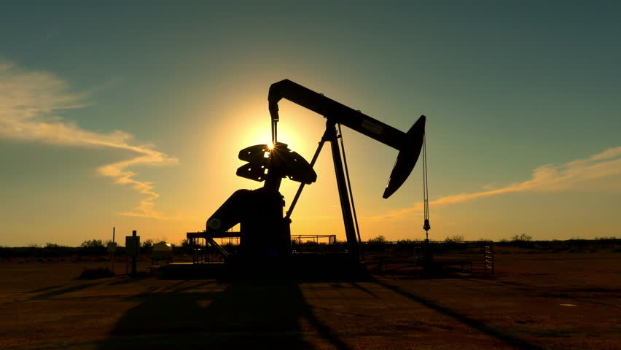
COPULA INTRODUCTION

Slide 13

WHAT IS COPULA ??
Copula is a function that is used to describe the dependency structure between random variables.
This means they can capture the way in which variables co-move without being influenced by the individual effect.
Marginal distributions is a individual probability distribution of each variable when considered separately from others.

Slide 14
WHAT IS COPULA ??
Therefore, Copula describes how likely it is for random variables to move together independent of their individual distributions.

Slide 15
WHAT IS COPULA ??
Imagine you have a bunch of random variables, (X₁, X₂,..., Xd), and you want to understand how they're connected.
Sklar's theorem provides a powerful way to do this by breaking down their joint distribution into TWO key components: 1. Marginals 2. Copula

Slide 16
WHAT IS COPULA ??
Conversely given the F or continuous variables, if F is the joint CDF and F1​,F2​ are the marginal CDFs , then there exist a copula C such that:
F(x1​,x2​​)=C(F1​(x1​),F2​(x2​)).
e marginals F1, F2, F3 and a Copula C, we can construct the joint CDF F.

Slide 17
Types of Copulas
Symmetrical Copulas- Symmetrical copulas treat the joint distribution of the random variables symmetrically.
Gaussian Copula: Used for modeling linear dependencies. Does not specifically model tail dependencies
Frank Copula: Capable of modeling both positive and negative dependencies. Does not exhibit tail dependence.
Plackett Copula: Suitable for modeling symmetric dependence. Does not distinguish between upper and lower tail dependencies. Does not exhibit tail dependence.

Slide 18
Types of Copulas
Does not model upper tail dependence well.
Asymmetrical Copulas: Asymmetrical copulas are designed to model different levels of dependence in the upper and lower tails.
Clayton Copula: Suitable for modeling lower tail dependence. Does not model upper tail dependence well.
Gumbel Copula: Suitable for modeling upper tail dependence. Does not model lower tail dependence well.

Slide 19
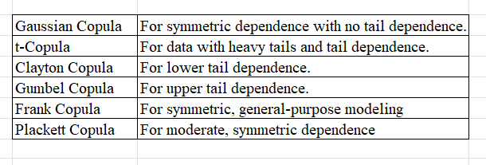
Types of Copulas
Type of Copulas and Their Dependence Characteristics
RESEARCH/DATA
RESEARCH DATA

Slide 20
RESEARCH & DATA

Slide 21
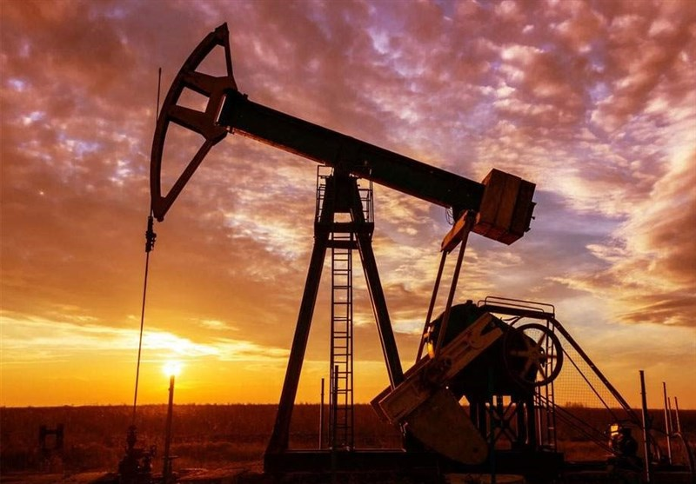

Slide 22
The data used in the study include daily oil prices, exchange rates and stock market indices for both developed and under developing nations.
Period Covered- January 1,2015 – March 31, 2024
Countries considered in our analysis are India, USA, France and Saudi Arabia
Data sources have been collected from varied sources.

Slide 23
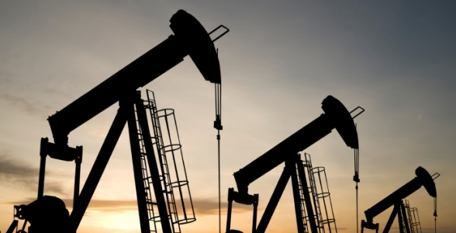
ABOUT DATA
Oil Prices
Brent Crude Oil FOB daily prices
OPEC Reference Basket (ORB) daily prices
Daily Stock market indices data for: Nifty50 (India) [^NSEI], S&P 500 (USA) [^GSPC], CAC 40 (France) [^FCHI], TASI (Saudi Arabia) [TASI.SR]
The data used in this study were obtained from the Yahoo Finance platform using the Python yfinance library.
Brent crude oil price data was downloaded from the FRED database,
OPEC oil price data was obtained from the OPEC Annual Statistical Bulletin.

Slide 24
Data Sources
The data used in this study were obtained from the Yahoo Finance platform using the Python yfinance library.
Brent crude oil price data was downloaded from the FRED database,
OPEC oil price data was obtained from the OPEC Annual Statistical Bulletin.
Brent Crude Leading global price benchmark for Atlantic basin crude oils. It is used to set the price of two-thirds of the world's internationally traded crude oil supplies. Used for Asia, Middle East, North America, Europe.
OPEC(Organization of the Petroleum Exporting Countries) Average price of crude oils from OPEC countries. Includes Iran (Iran Heavy), Kuwait (Kuwait Export), Saudi Arabia (Arab Light), United Arab Emirates (Murban)..etc Alternate benchmark for India to check result consistency.

Slide 25
Oil Price Benchmarks
Brent Crude Leading global price benchmark for Atlantic basin crude oils. It is used to set the price of two-thirds of the world's internationally traded crude oil supplies. Used for Asia, Middle East, North America, Europe.
OPEC(Organization of the Petroleum Exporting Countries) Average price of crude oils from OPEC countries. Includes Iran (Iran Heavy), Kuwait (Kuwait Export), Saudi Arabia (Arab Light), United Arab Emirates (Murban)..etc Alternate benchmark for India to check result consistency.
Periods:
Pre-Covid: January 1, 2015 - February 29, 2020
During-Covid: March 1, 2020 - February 28, 2022
Post-Covid: March 1, 2022 - March 31, 2024
Significance: Understanding dependence dynamics in different periods.
Conversion: Oil prices converted into local currencies.

Slide 26
SPLITTING DATA
Periods:
Pre-Covid: January 1, 2015 - February 29, 2020
During-Covid: March 1, 2020 - February 28, 2022
Post-Covid: March 1, 2022 - March 31, 2024
Significance: Understanding dependence dynamics in different periods.
Conversion: Oil prices converted into local currencies.
METHODOLOGY

Slide 27
METHODOLOGY

Slide 28










Methodology
In this study, we apply the copula approach.
A crucial part of this analysis involves modeling the conditional mean and variance of the financial return series accurately.
Therefore we will apply GARCH model.

Slide 29


What is GARCH Model?
GARCH Model is used to model the volatility in the time series.
By this, we can standardize series to account for the changing volatility resulting in residual that better fit a data.
Standard GARCH models assume symmetry.
This means the model assumes positive and negative shocks have the same impact on future volatility.
Which might not be appropriate for financial data that often exhibit asymmetrical patterns.

Slide 30

But Standard GARCH model have Limitations!!
Financial data often shows a phenomenon called the leverage effect.
This means bad news (negative shocks) tend to have a greater impact on volatility than good news (positive shocks) of the same size.

Slide 31
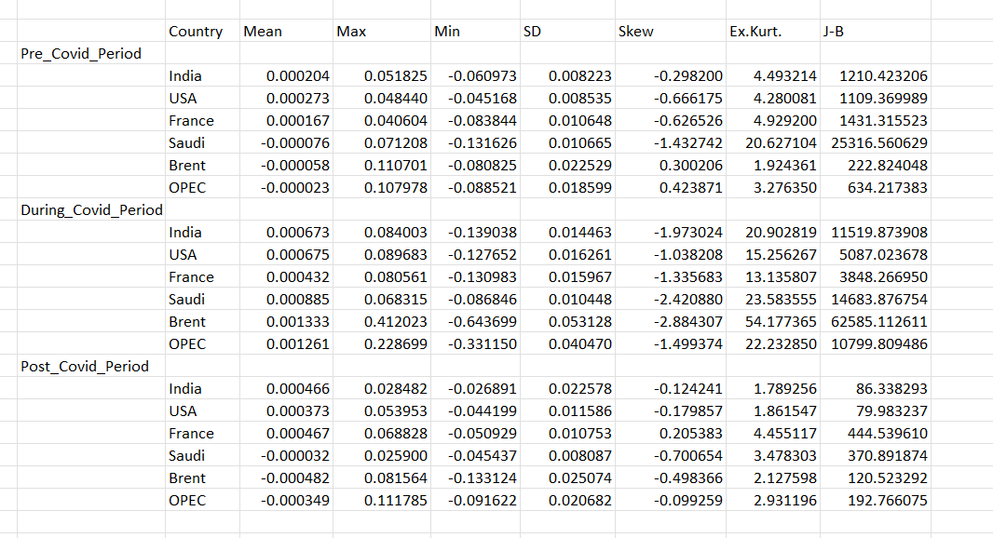


Negative Skewness of Financial Data returns
High Kurtosis
Departure from normality
Summary statistics for daily log returns on market indices (in local currency), Brent oil price (in dollars), and OPEC oil price (in dollars).
Therefore to account for leverage effect we will apply the extended version of GARCH model that is GARCH-GJR(GLUTEN-JAGANATHAN-RUNKLE) Model

Slide 32
Negative Skewness of Financial Data returns
High Kurtosis
Departure from normality
Therefore to account for leverage effect we will apply the extended version of GARCH model that is GARCH-GJR(GLUTEN-JAGANATHAN-RUNKLE) Model

Slide 33







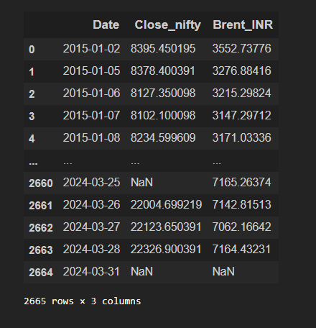
Marginal Estimation
STEPS
Overview of Data for Indian stock market index for pre-covid Period.
Close_Nifty = Nifty50
Brent_INR= Oil Price for Brent Crude Oil

Slide 34
Marginal Estimation
We will apply two methods to estimate the marginal distributions from the GARCH Model.
First Method: Obtaining Filtered Standardized residuals
Second Method: The empirical distribution to estimate marginal Distribution.
STEPS
Overview of Data for Indian stock market index for pre-covid Period.
Close_Nifty = Nifty50
Brent_INR= Oil Price for Brent Crude Oil

Slide 35
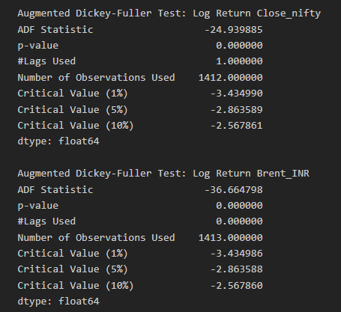
OVERVIEW
Overview of Data for Indian stock market index for pre-covid Period.
Close_Nifty = Nifty50
Brent_INR= Oil Price for Brent Crude Oil
STEPS
We made our series stationary by applying log to our series and validated through ADF test.
These results suggest that both "Log Return Close_nifty" and "Log Return Brent_INR" are stationary time series as their ADF statistics are significantly negative.
p-values are close to zero indicating strong evidence against the presence of a unit root

Slide 36
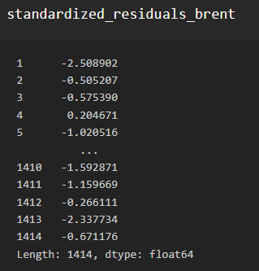
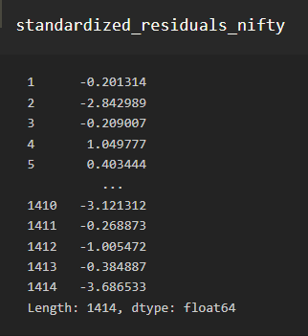
ADF TEST
We made our series stationary by applying log to our series and validated through ADF test.
STEPS
These results suggest that both "Log Return Close_nifty" and "Log Return Brent_INR" are stationary time series as their ADF statistics are significantly negative.
p-values are close to zero indicating strong evidence against the presence of a unit root
In next step we have fit our GARCH model into our data for both Clost_Nifty and Brent_INR.
Extracted standardized residuals.

Slide 37
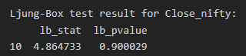
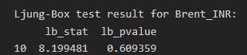
GARCH-GJR MODEL
STEPS
In next step we have fit our GARCH model into our data for both Clost_Nifty and Brent_INR.
Extracted standardized residuals.
Ljung-Box test to check for autocorrelation
A non existing dependence between sets of variables results in incorrect copula estimation.
For both Brent_INR and Close_nifty, the p-values are higher than significance level of 0.05.

Slide 38
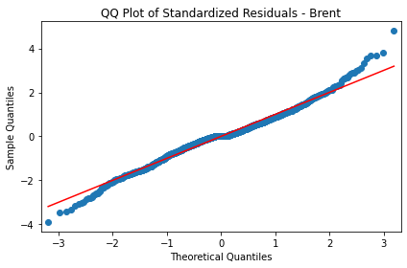
LJUNG BOX TEST
Ljung-Box test to check for autocorrelation
A non existing dependence between sets of variables results in incorrect copula estimation.
STEPS
For both Brent_INR and Close_nifty, the p-values are higher than significance level of 0.05.
The marginal distributions are estimated via kernel smoothing.
Kernel smoothing may not be optimal for the tails of the distribution.
So Extreme value theory (EVT) is applied to the tails.
Points above the line at right tail and Below the Line at the Left Tail
The data has more extreme low values than expected.
The left tail is heavier than the theoretical distribution.
The data has fewer extreme high values than expected

Slide 39

QQ & EVT
The marginal distributions are estimated via kernel smoothing.
Kernel smoothing may not be optimal for the tails of the distribution.
So Extreme value theory (EVT) is applied to the tails.
Points above the line at right tail and Below the Line at the Left Tail
The data has more extreme low values than expected.
STEPS
The left tail is heavier than the theoretical distribution.
The data has fewer extreme high values than expected
10% of the standardized residuals for the upper and lower thresholds are used in order to estimate the parametric Generalized Pareto Distribution
Computing the empirical cumulative distribution function (ECDF) for both columns.
Converted that into Uniform distribution for further copula analysis.
Optimal copula function
Alkaline Information Criterion AIC = -2 * LLF + 2 * Parameters
Bayesian information criterion BIC= -2 * LLF + log(T) * Parameters
Log-likelihood functions.

Slide 40
GPD & ECDF
10% of the standardized residuals for the upper and lower thresholds are used in order to estimate the parametric Generalized Pareto Distribution
Computing the empirical cumulative distribution function (ECDF) for both columns.
Converted that into Uniform distribution for further copula analysis.
STEPS
Optimal copula function
Alkaline Information Criterion AIC = -2 * LLF + 2 * Parameters
Bayesian information criterion BIC= -2 * LLF + log(T) * Parameters
Log-likelihood functions.
We have fit 9 copulas to the data using copula library package in R programming language.
Student’s t
Clayton
Rotated Clayton
Frank
Plackett
Gumbel,
Rotated Gumbel
Gaussian (Normal)
After applying this steps to India-Pre_Covid, I will apply to India-Post Covid, India-During_Covid.
After India, I will apply to USA, France, Saudi Arabia for 2 different oil prices- Brent and OPEC

Slide 41
COPULA
We have fit 9 copulas to the data using copula library package in R programming language.
Student’s t
Clayton
Rotated Clayton
Frank
Plackett
Gumbel,
Rotated Gumbel
Gaussian (Normal)
STEPS
After applying this steps to India-Pre_Covid, I will apply to India-Post Covid, India-During_Covid.
After India, I will apply to USA, France, Saudi Arabia for 2 different oil prices- Brent and OPEC

Slide 42
We have fit 9 copulas to the data using copula library package in R programming language.
COPULA
Student’s t
Clayton
Rotated Clayton
Frank
Plackett
Gumbel,
Rotated Gumbel
Gaussian (Normal)
After applying this steps to India-Pre_Covid, I will apply to India-Post Covid, India-During_Covid.
After India, I will apply to USA, France, Saudi Arabia for 2 different oil prices- Brent and OPEC

Slide 43
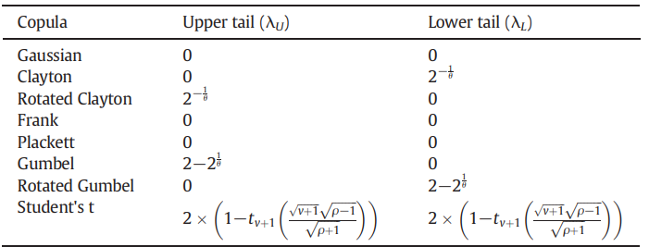
Dependence Measure
Three metrics of dependence are used in this study: the index of tail dependency, Kendall's tau, & Pearson's rho.
Tail Dependency- Tail dependency is a characteristic of an underlying copula function that is used to condense the possibility of extreme joint movements among a group of variables.
Zero tail dependencies characterize Gaussian, Frank, and Plackett copulas, which don't reveal anything about extreme co-movements or tail relationship structure.
Tail Dependence for different copulas.

Slide 44
Dependence Measure
The goal is to understand if the relationship between oil prices and stock market indices is stronger during extreme market conditions.
We could be looking at dependencies in the upper tail (high values) separately, or the lower tail (low values) separately.
We might also consider dependencies in both tails, but not necessarily in the same way or to the same extent (unequally).
This information is important for risk management, as it helps in anticipating how variables might behave under extreme conditions.
RESULTS & DISCUSSIONS

Slide 45
RESULTS & DISCUSSIONS

Slide 46


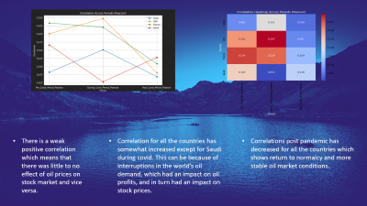
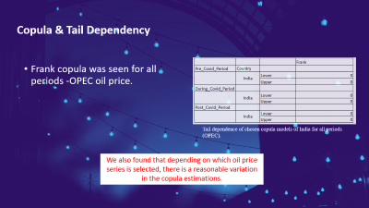
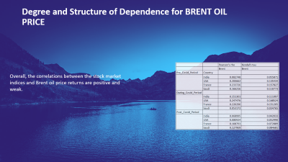
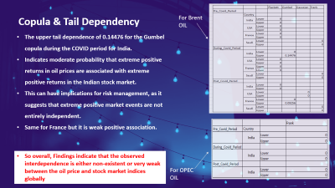
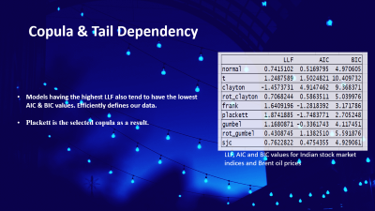
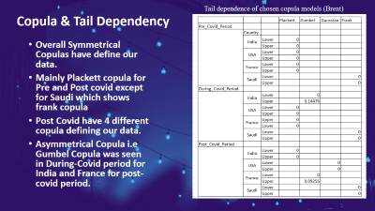
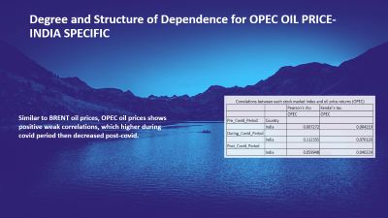


Slide 53
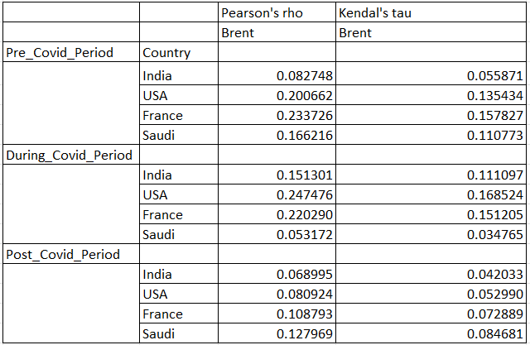
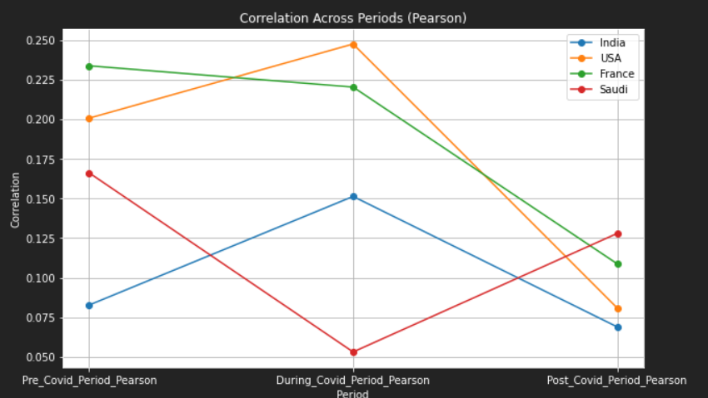
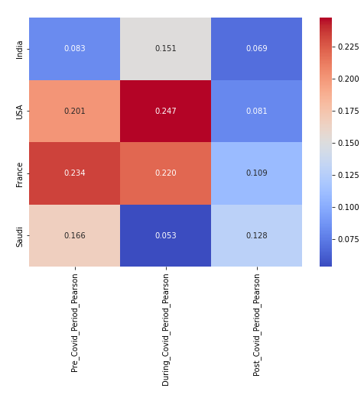
Degree and Structure of Dependence for BRENT OIL PRICE
Overall, the correlations between the stock market indices and Brent oil price returns are positive and weak.

Slide 54
There is a weak positive correlation which means that there was little to no effect of oil prices on stock market and vice versa.
Correlation for all the countries has somewhat increased except for Saudi during covid. This can be because of interruptions in the world’s oil demand, which had an impact on oil profits, and in turn had an impact on stock prices.
Correlations post pandemic has decreased for all the countries which shows return to normalcy and more stable oil market conditions.

Slide 55
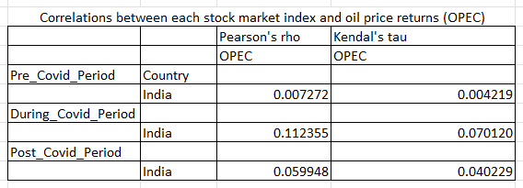
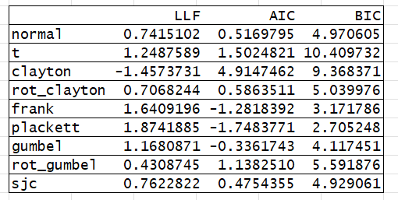
Degree and Structure of Dependence for OPEC OIL PRICE- INDIA SPECIFIC
Similar to BRENT oil prices, OPEC oil prices shows positive weak correlations, which higher during covid period then decreased post-covid.

Slide 56

Copula & Tail Dependency
Models having the highest LLF also tend to have the lowest AIC & BIC values. Efficiently defines our data.
Plackett is the selected copula as a result.
LLF, AIC and BIC values for Indian stock market indices and Brent oil prices

Slide 57

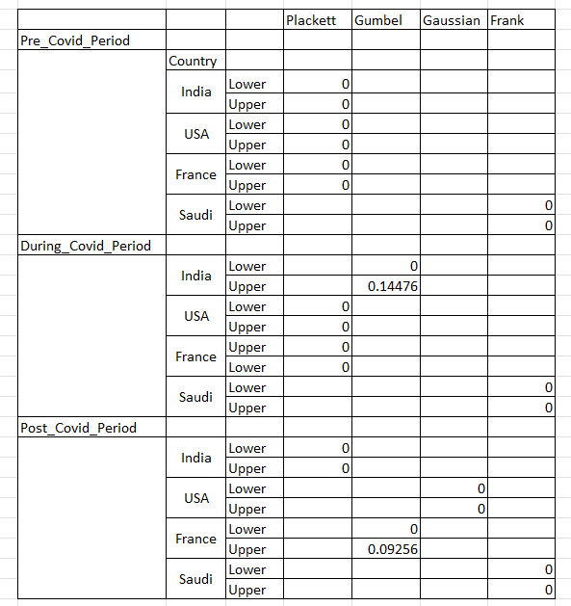
Copula & Tail Dependency
Tail dependence of chosen copula models (Brent)
Overall Symmetrical Copulas have define our data.
Mainly Plackett copula for Pre and Post covid except for Saudi which shows frank copula
Post Covid have 4 different copula defining our data.
Asymmetrical Copula i.e Gumbel Copula was seen in During-Covid period for India and France for post-covid period.

Slide 58
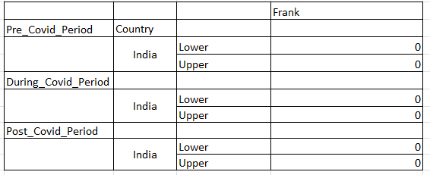
Copula & Tail Dependency
Frank copula was seen for all periods -OPEC oil price.
Tail dependence of chosen copula models of India for all periods (OPEC).
We also found that depending on which oil price series is selected, there is a reasonable variation in the copula estimations.

Slide 59
Copula & Tail Dependency
For Brent OIL
The upper tail dependence of 0.14476 for the Gumbel copula during the COVID period for India.
Indicates moderate probability that extreme positive returns in oil prices are associated with extreme positive returns in the Indian stock market.
This can have implications for risk management, as it suggests that extreme positive market events are not entirely independent.
Same for France but it is weak positive association.
So overall, Findings indicate that the observed interdependence is either non-existent or very weak between the oil price and stock market indices globally
For OPEC OIL
CONCLUSION

Slide 60
CONCLUSION

Slide 61
Conclusion
We specifically investigate if there is a correlation between the movement of equity market indices and costs of oil?
When there are extreme events, does the dependence (if any) increase?
Does the reliance alter before, during, or after the COVID-19 pandemic?
Does it matter which oil price series is chosen?

Slide 62
Conclusion
Variation in Tail Dependence: The choice of oil price series (Brent vs. OPEC) leads to differences in tail dependence and copula parameter estimates due to variations in the kind and quality of oil.
Brent oil prices are market-determined, while OPEC oil prices are controlled by the organization, influencing production to maintain specific price ranges.
Brent oil prices are a better fit for studies on market dynamics as they reflect true market conditions, unlike OPEC oil prices, which are artificially managed.

Slide 63
Conclusion
The correlation between oil prices and stock market indices is generally weak, indicating that oil price fluctuations have a minimal direct impact on stock market returns and vice versa.
Symmetrical copulas, primarily the Plackett copula, define the dependence structure for most countries and periods, indicating that extreme positive and negative returns are equally likely to co-occur.
Saudi Arabia consistently showed a Frank copula, suggesting a different dependence structure. Mainly because of the oil exporter.
Asymmetrical dependence, indicated by the Gumbel copula, was observed for India during the COVID period and France in the post-COVID period.

Slide 64
Final Conclusion
The overall weak interdependence implies that oil prices and stock market indices operate largely independently in normal market conditions. However, during periods of market stress or extreme events, there is a moderate probability of co-movement, especially for India During Covid period.
FUTURE WORK

Slide 65
FUTURE WORK

Slide 66
Future Work
Future research should continue to explore these relationships with more granular data including the impact of other external shocks such as geopolitical events or climate policies.
Other macroeconomic variables should be further investigated to provide a more holistic view of the oil-stock market interdependence

Slide 67

Do you have any Questions ??

